Slide 1
BIS 403 - Applied Systems Design College: Peirce College Professor: Robert Heubner Group Members: J. Sherif & M. Morrison Case Study: Personal Trainer Case Study #4
Tasks 1&2, completed by Jilalo Sherif
Tasks 3&4, completed by Morrese Morrison

Slide 2
System Requirements
Personal Trainer system categories fall into five categories:
Output
Inputs
Processes
Performance
Controls

Slide 3
Outputs
System generation of reports on customers’ unpaid balances,
FAQs and trends,
Client activity and fitness tracker log,
Exception report, &
Seasonal discount and promotion plans

Slide 4
Inputs
Information gathering of member preferences,
Member activity and loyalty,
Member feedback,
Continuous communications (e-mails and brochures).

Slide 5
Processes
PoS (point of sale) terminals,
ID scanner,
Automated staff sign-in and sign-out,
Staff scheduling,
Time keeping

Slide 6
Performance
Actual vs. Expected performance review,
Standardized forms,
Periodic employee productivity evaluation,
User and password control and expiration,
Data reconciliation,
Member retention

Slide 7
Controls
Internal audit,
Facility Security,
Injury prevention
Cameras,
Fire exits

Slide 8
Scalability
Definition:
Scalability is a characteristic of a system, implying that the system can be expanded, modified, or downsized easily to meet the rapidly changing needs of a business enterprise. As president of Personal Trainer, there are scalability issues that Susan should consider:
Scalability issues:
Elasticity to handle more than usual business volume and transactions,
company growth and branches expansion
Projected number of customers averaged
High and low seasons

Slide 9
Scalability Issues contd.
Network capacity
Cloud Storage
Account and Username Security, and Password Expiration
Cyber Security
Manpower and staffing
Resilience and data backup

Slide 10
Applicable Sample Method - Current Members (Part 1 of 2)
To conduct a proper survey of the current personal trainer members, Susan should utilize the Stratified Sample method.
This method broadens the overall scope of the sample data, and provides an overall view of the current member population to further analyze.
Due to the their being an estimated 300 to 500 current members in each facility, and the mean number of members being 400, 25% of that population should be analyzed. This means 100 different members will be analyzed per facility. Multiply 100 by the total number of Personal Trainer trainer facilities and you have a total number of the current member population that may be analyzed.

Slide 11
Applicable Sample Method - Prospective Members (Part 2 of 2)
To conduct a proper survey of the current personal trainer members, Susan should utilize the Random Sample method.
The current rate of prospective members are currently not tracked, however utilizing the Random Sample method will allow Susan to generalize the population as well as make predictions.
These random samples should be half of the overall prospective member population per facility every month. Sample data such as what activities the perspective members are interested in, their age and their sex should be recorded.

Slide 12
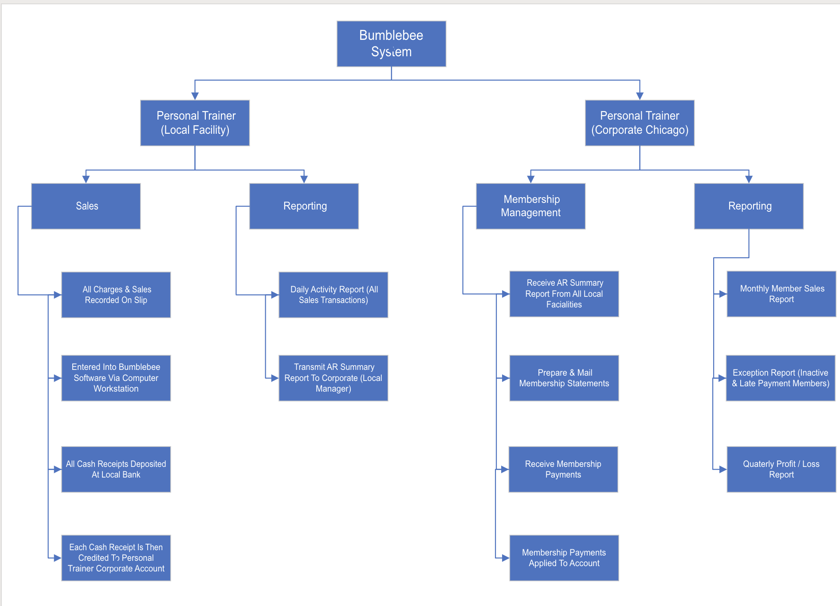
Personal Trainer Functional Decomposition Diagram

